Slide 1
Iris classification
classify the different species of the Iris flower

Slide 2
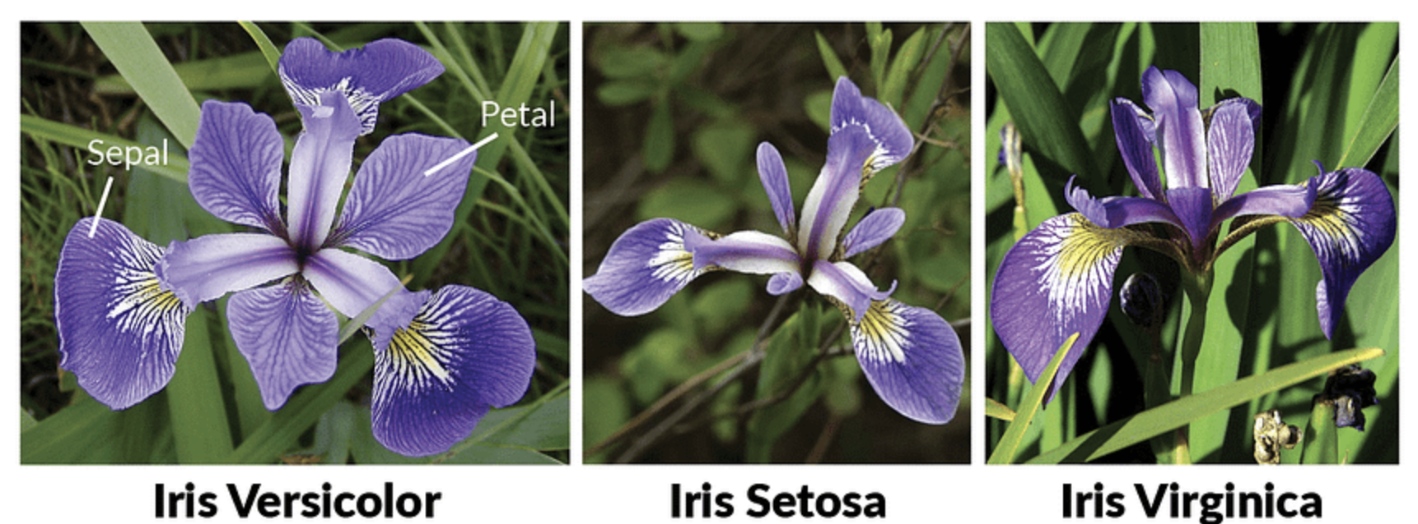
Types Of IRIS Flower

Slide 3

Problem Statement
Create the model that can classify the different species of the Iris flower.
Steps to build
Create the dataset.
Build the model
Train the model
Make predictions

Slide 4





Important Modules

Slide 5
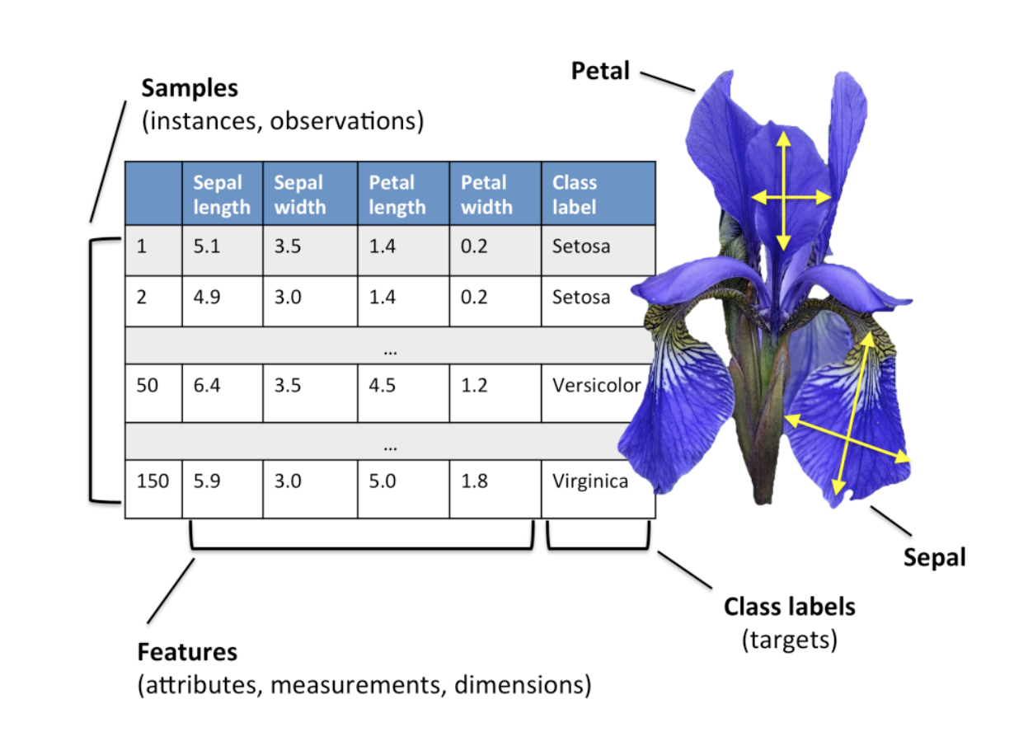
Data Set
The data set consists of:
150 samples
3 labels: species of Iris (Iris setosa, Iris virginica and Iris versicolor)
4 features: Sepal length, Sepal width, Petal length, Petal Width in cm

Slide 6


Tools

Slide 7
Thank You

